Slide 2

QUEER THEORY
Dr. J. Amalaveenus
Asst Prof of English
School of Languages and Culture
St. Joseph’s College (Auto)
Tiruchirappalli-620002

Slide 3
  LGBT – Lesbians, gay, bisexual, transgenders
  Queer - Non-hetrosexual (asexual, intersex, pansexual polyamorous people ,
  crossdressing)
  Earlier – third gender
  Q-Umbrella term

Slide 4
PROBLEMS
Homophobic (fear or hatred of homosexuality)
Trans phobic
Social exclusion
Family rejection
Religious threat
Terminology
Sexual abuse
Unemployment
Harrasment/bullying

Slide 5
QUEER THEORY
There are two accusation against feminism
1. left out black women
2. left out lesbians-given imp for heterosexualism
Lesbianism should be regarded as the most complete form of feminism

Slide 6
In 1990s a less essentialist notion of lesbianism had emerged- QUEER THEORY
BREAKS FROM LESBIAN FEMINISM-MAKES NEW ALLEGIANCES WITH GAY MEN RATHER THAN WITH OTHER WOMEN.
Queer theory rather than being women centered sees an identity of political and social interests with non hetrosexuals.

Slide 7
Difference between Queer theory and Lesbian Feminism?
Queer theory got its influence from post –structuralism.
Deconstructing binary opposition
Paired opposite is not absolute
Since each term in the paring understood by the other.
Reverse the hierarchy

Slide 8
Gendered Fluidity
Hetrosexual/homosexual is deconstructed
The opposition is unstable

Slide 9

Gender Fluidity is about people finding that the line between sexes isn't as solid as they thought.

Slide 10
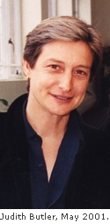
Judith Butler
.
‘S GENDER TROUBLE

Slide 11
In her most influential book Gender Trouble (1990), Butler argued that feminism had made a mistake by trying to assert that 'women' were a group with common characteristics and interests.
Rather than opening up possibilities for a person to form and choose their own individual identity

Slide 12
Butler notes that feminists rejected the idea that biology is destiny. But they accept-
masculine and feminine genders would inevitably be built, by culture, upon 'male' and 'female' bodies, making the same destiny just as inescapable. That argument allows no room for choice, difference or resistance.
In other words, rather than being a fixed attribute in a person, gender should be seen as a fluid variable which shifts and changes in different contexts and at different times.

Slide 13
In other words, gender is a performance; it's what you do at particular times, rather than a universal who you are.
Butler argues that we all put on a gender performance, whether traditional or not, anyway, and so it is not a question of whether to do a gender performance, but what form that performance will take. By choosing to be different about it, we might work to change gender norms and the binary understanding of masculinity and femininity.
This idea of identity as free-floating, as not connected to an 'essence', but instead a performance, is one of the key ideas in QUEER THEORY

Slide 14
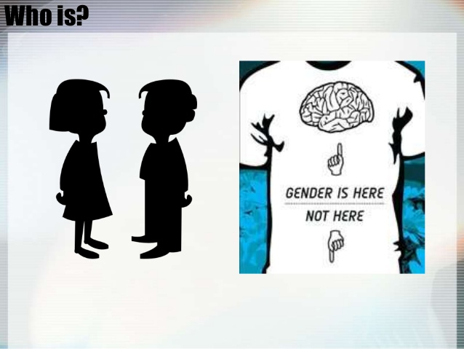

Slide 15
Body(Female,Male) and Gender
All bodies are gendered
from the beginning of their social existence
(and there is no existence that is not social),
which means that there is no “natural body”
that pre-exists its cultural inscription. This
seems to point towards the conclusion that
gender is not something one is, it is something
one does, an act, or more precisely, a sequence
of acts, a verb rather than a noun, a “doing”
rather than a “being”

Slide 16


Slide 17
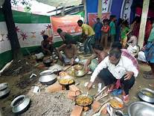

Slide 18
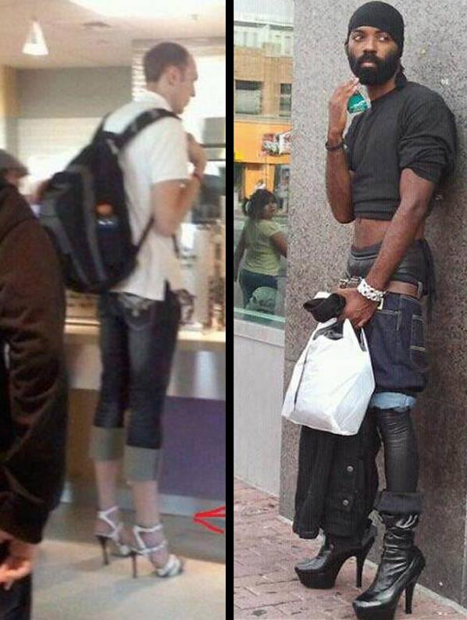
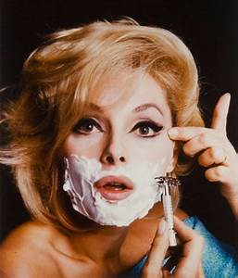
All the World’s a Stage, and Gender—Merely a Performance

Slide 19
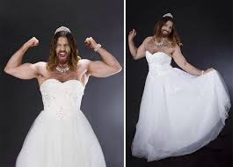
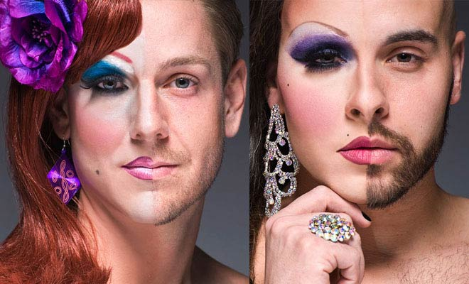

Slide 20
UNDERSTANDING AND ACCEPTANCE
FELLOW HUMAN BEING
RESPECT THE CHOICE
SEEING THINGS AS IT IS
RECOGNITION
STOPPING VERBAL ABUSE
COMING OUT FROM HOMOPHOBIA AND TRANSPHOBIA

